Slide 1
SQL Security Principals 101
William Assaf,
He/Him,
Title,
Company

Slide 2
Explore PASS

Slide 4

William Assaf
Principal Consultant, Microsoft MVP Data Platform, PASS Regional Mentor
He/Him
Title
Company
in/williamdassaf
@william_a_dba
Co-author, Microsoft Press, SQL Server Administration Inside Out 2017, 2019.

Slide 5
Agenda
Logins, Users, and Authentication
Roles, “Ownership”, Schemas
Auth to Azure SQL DB
Useful permissions, scenarios
SQL Injection
Demo
Notes:
Today we’re going to cover a lot of important foundational material about security, accounts, authentication. For folks new to SQL Server security design and administration, this will be a great foundation for your learning. For those experienced in SQL admin, this will be a thorough evaluation of what you know, or thought you know, and maybe some gaps in what you know. I think there is content in here to interest everyone in the SQL career lifecycle, and I’m not just guessing at that. I got my first DBA job in 2006. I’ve been giving a presentation on Security at User Groups and SQLSaturdays basics for years, it was one of the first topics I started speaking technically on a decade ago. As my own experience has deepened and broadened throughout my career, so has the content I build into this presentation. So I’m going to start basic, and build quickly from there, focusing my content around common hurdles and tasks that database administrators face, in the hopes of deepening or broadening your experience, as well.
This is session one of a four part Learning Pathway on security. In subsequent presentations over the next three days,
John Morehouse is presenting part two, Understanding Modern Data Encryption Offerings for SQL Server, including a lot more information on all the various sorts of encryption, plus some important security features of SQL Server like Transparent Data Encryption and Always encrypted.
Jeff Renz is presenting on Securing Your Data In Azure: Tips and Tricks, which covers Advanced Threat Detection, the Azure Key Vault, cloud secure connection strings, and certified data sets for security in PowerBI.
Ed Leighton-Dick will cap it off with a presentation on Building a Security Dashboard for SQL Server, talking about when certs expire and what does that actually mean, more on Azure Advanced Threat Detection, SQL Audit and monitoring.
But today we’re setting the stage for a good conversation around security at PASS Virtual Summit 2020, especially around how permissions behave inside each database, how you can design database security, the relationships between logins, users, and databases. We’re start first by introducing the way security things are normal configured, but we’ll also discuss weird ways they veer from the normal.

Slide 6
Why is Security Important?
Proper implementation of SQL security principals:
Decreases administrative effort
Decreases application complexity
Decreases database surface area

Slide 7
Login vs User
Database User
Server Login
Has a database context
Often linked to a Login*
Does not have a password*
Stored in a Database
Included in DB Restore
Given access to SELECT, UPDATE, EXECUTE, CREATE TABLE, etc.
*Most of the time. We’ll talk about it.
Connects to a SQL Instance
Linked to AD (Windows Auth)
or have a password (SQL Auth)
Stored in the Master database, so not in other DB restores
Given access to CONNECT, VIEW SERVER STATE, CREATE DATABASE, etc.

Slide 8
Login vs usEr
Database User
Has a database context
Often linked to a Login*
Does not have a password*
Stored in a Database
Included in DB Restore
Given access to SELECT, UPDATE, EXECUTE, CREATE TABLE, etc.
*Most of the time. We’ll talk about it.
Server Login
Connects to a SQL Instance
Linked to AD (Windows Auth)
or have a password (SQL Auth)
Stored in the Master database, so not in other DB restores
Given access to CONNECT, VIEW SERVER STATE, CREATE DATABASE, etc.

Slide 9
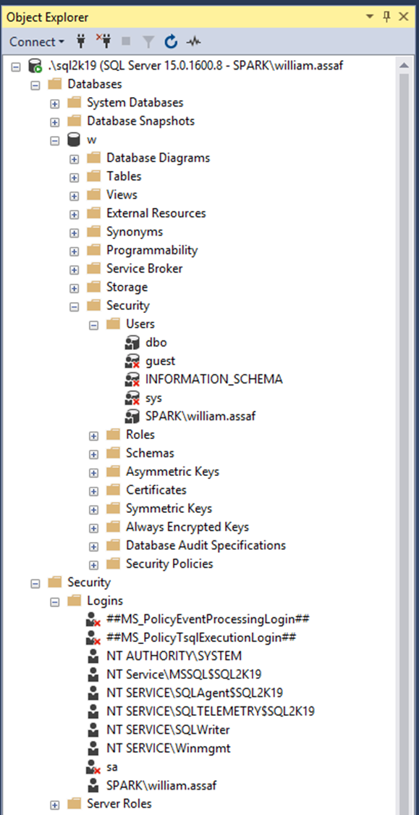
LOGIN VS USER
Database User
Has a database context
Often linked to a Login*
Does not have a password*
Stored in a Database
Included in DB Restore
Given access to SELECT, UPDATE, EXECUTE, CREATE TABLE, etc.
Server Login
Connects to a SQL Instance
Linked to AD (Windows Auth)
or have a password (SQL Auth)
Stored in the Master db, so not in other DB restores
Given access to CONNECT, VIEW SERVER STATE, CREATE DATABASE, etc. *Most of the time. We’ll talk about it.

Slide 10
On the topic of Groups…
Always assign permissions to AD groups, insist on it.
BUT
Be aware of who is a member of those groups, and what groups are a member of groups, and what groups are a member of those groups…
Devs -> App Support -> QA -> Financial Analysts…

Slide 11
On the topic of Groups…
You can interrogate AD for the members of security groups
EXEC master..xp_logininfo
@acctname = 'domain\groupname',
@option = 'members'
BUT it only returns FIRST level members, not members of groups that are members of the group. Instead use PowerShell:
Get-ADGroupMember -identity 'Development' -recursive

Slide 12
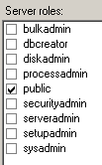
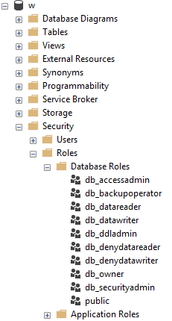
Roles
Roles are security principals that can grant permissions to other security principals.
Logins are added to Server Roles
Users are added to Database Roles
Built-in Roles to provide a standard for access.
Instead, assign more specific permissions when possible. Your data may not be homogenous in terms of sensitivity/permissions to access.

Slide 13
PUBLIC
Every login/user is a member of “public” roles.
Public is a server role that should never be granted any additional permissions, authorization or ownership.
Every database user/roles belongs to a public database role.
When a user has not been granted or denied specific permissions on a securable, the user inherits the permissions granted to public.

Slide 14
PUBLIC
Check for this.
Toolbox: public permissions.sql
Permissions assigned to the public role is a clear sign of lazy developers. Don’t be a lazy developer.
Should fail any security audit.
The strategy to undo a security architecture based around public can be complicated, involves lots of testing.

Slide 15
GUEST
Check for this.
Toolbox: guest permissions.sql
The GUEST account permissions are granted to any login who does not have a mapped user in the database.
For what should be very obvious reasons, never grant any permissions, even CONNECT, to GUEST, unless you understand what you’re doing.
Not a secure solution for future access.

Slide 16
Logins
A SQL Server Login is a server-level security principal
A User is a database-level principal
Logins are given a default database.
CONNECT will fail if the Default Database is not accessible.
Best practice: set Default Database to the intended User Database, or to TempDB, which is always there, but not persistent.

Slide 17
Logins vs users
Remember, a Server Login is what authenticates a user connection to the SQL Instance.
A Database User provides a Login with database access.
“Login” is a server level security principal.
“User” is a database level security principal.

Slide 18
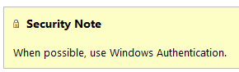
Sql logins
SQL Logins are authenticated by SQL Server.
Strongly encouraged to Enforce password policy, which can include password expiration, inheriting from the same settings in Windows.
Unfortunately, the password policy is optional!
Multiple failed SQL auth login attempts will Lock Out, which a DBA must resolve.

Slide 19
Windows vs SQL Auth
Remember, a Login is what authenticates the user to the SQL Server instance, not a User.
In a typical business environment,
Windows Authentication means that
account creation/termination,
security group membership,
password policy,
are all handled by an existing corporate security administration infrastructure.

Slide 20
Windows vs SQL Auth
Windows Authentication is the default security model for SQL Server, by default the only security model, and cannot be disabled.
Choosing Mixed Mode as a server option enables SQL Logins and allows the “sa” account to be enabled.

Slide 21
Apps + windows auth
The Windows Authentication model creates Server Logins that are linked to Local Windows or Domain Accounts
Preferably linked to AD Security Groups, not individuals, so this membership is also managed by your existing security infrastructure.
From an Internet-facing server, Kerberos may be required to authenticate a Windows User directly from the application server to the SQL Server.
Can increase the complexity of an application loadout, but this is the Enterprise approach.

Slide 22
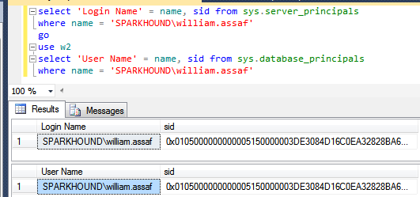
Logins + users
A User can be linked to any Server Login – the names don’t actually have to match.
A SID (Security-IDentifier) is shared by User and Login.

Slide 23
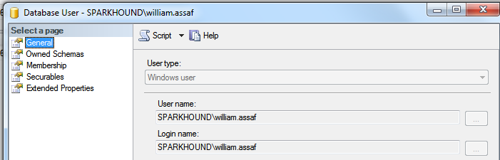
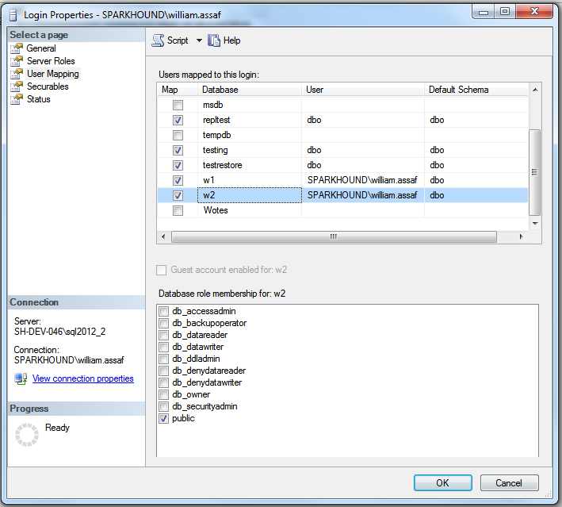
User MAPPING
Logins are mapped to Users in the User Mapping page of the Login properties dialog.

Slide 24
Orphaned sid
SQL Auth Logins can become disconnected from their Database Users when a database is restored from another server.
Only occurs with SQL Authenticated Logins, not Windows Authenticated Logins
Commonly occurs when a database is restored from one server to another
To re-associate a database user to a server login:
ALTER USER username WITH LOGIN = loginname;

Slide 25
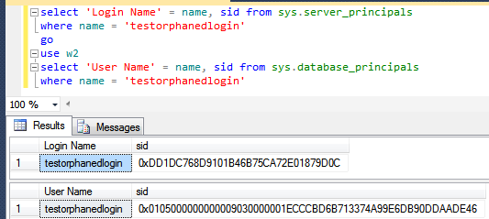
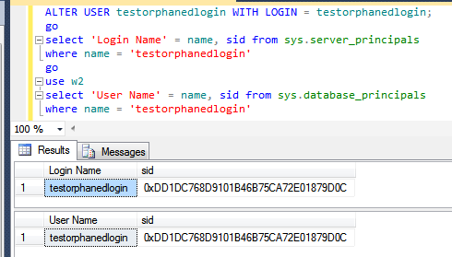
Fix orphaned sid
Fix: SQL Auth Login becomes disconnected from its User
Toolbox: fix orphaned sid.sql

Slide 26
Sql login migration
Not possible to reverse-engineer a SQL Auth Login password.
When migration applications from one SQL Server instance to another, migration of SQL Logins is accomplished by:
Backup+restore of the master database (complicated) -OR-
Creating SQL Logins with same SID but new password (not desirable) -OR-
Generating a hash of the password and same SID (most desirable) Let’s go more into that….

Slide 27
Sql login migration
Microsoft has provided a pair of sprocs to generate the hash of passwords: support.microsoft.com/kb/918992
sp_hexadecimal + sp_help_revlogin
But don’t forget to migrate the server-level permissions:
Toolbox: security Script servers.sql

Slide 28
Sql login SIDS
Creation of the SQL Login with its existing password AND SID is critical.
This is also important for setting up new Availability Groups, as the Login SIDs must match on every replica.
A regular proactive check for all SQL Server instances in Availability Groups:
Check that all SQL Logins exist
AND they have the same SID, not just same NAME

Slide 29
Contained databases
Not very common architecture but notable.
Moves authentication from the Server level directly to the Database level.
A contained database owner, for example an Application owner, has full control over security in the database.
No server-level (or sysadmin) permissions necessary
Contained database has no configuration dependencies on the instance, it can be easily moved to another instance.

Slide 30
Contained databases
In SQL Server, Authentication can be made with Windows Auth logins or Contained Database Users where the password is maintained inside the database.
Agent jobs, system error messages, linked server information, and system settings are all inside the contained database instead of master or msdb.

Slide 31
Contained databases
What this means is that this syntax, which heretofore made no sense, on a contained database is perfectly valid:
USE [SomeUserDatabase];
CREATE USER BI_User WITH PASSWORD ='strongpassword';

Slide 32
Contained databases
A database platform where all the major necessities for authentication and system objects are stored in the user database…
No system databases needed, so the database is easily portable between servers…
What does this sound like?
Azure SQL Database!

Slide 33
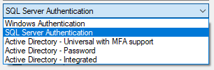
Azure SQL DB
Additional types of authentication since SSMS 2016
“Active Directory” options used for Azure AD only

Slide 34
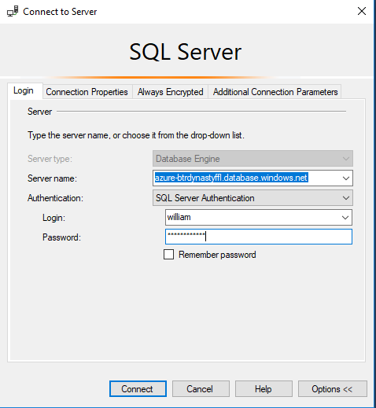
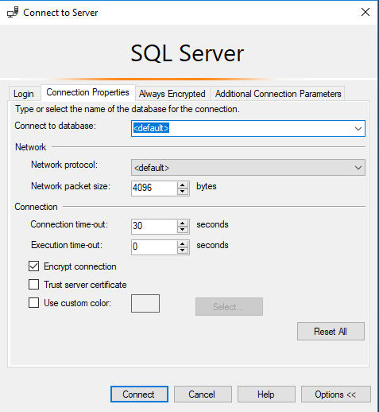
Azure SQL DB
Only real caveat when connecting to an Azure SQL DB: You youths can’t use USE, you must set the context at login.

Slide 35
Azure SQL DB
You can use Azure Active Directory accounts only for Azure SQL contained database users, but not for Azure SQL server logins. Example: in [SomeUserDatabase]
CREATE USER [reportuser@domainname.onmicrosoft.com] FROM EXTERNAL PROVIDER;
Only Active Directory accounts can create other Active Directory accounts in Azure SQL Database. You add the first via the Azure Portal.

Slide 36
Azure SQL DB
Otherwise, most (not all) permissions, objects, schema operate the same on Azure SQL Database, Azure SQL Managed Instance (MI), SQL Server, and SQL Server on Linux.
In this presentation when we’re talking about permissions, stored procs, views, functions, it’s the same for any platform.

Slide 37
A BIT ON Connection providers
OLEDB was un-deprecated, re-released in ‘18. https://blogs.msdn.microsoft.com/sqlnativeclient/2017/10/06/announcing-the-new-release-of-ole-db-driver-for-sql-server/
Install and Convert your OLEDB connection strings from sqlncli11 or sqloledb, to the new MSOLEDBSQL.
There is also a relatively new ODBC Driver 17 for SQL Server. https://techcommunity.microsoft.com/t5/SQL-Server/ODBC-Driver-17-for-SQL-Server-Released/ba-p/385825
Both replace the OLEDB/ODBC functionality of the SQL Native Client (SNAC) which is no longer maintained.
New OLEDB or ODBC can connect to SQL on-prem and Azure
Important to update sqlncli10 for Availability Groups
https://www.sqltact.com/2019/06/actual-emails-will-msoledb-work-for.html

Slide 38
Basic user permissions
DML*
SELECT
DELETE
UPDATE
INSERT
REFERENCES
*Data Manipulation Language
DDL**
ALTER
CONTROL
VIEW DEFINITION
CREATE
DROP
EXECUTE **Data Definition Language
Modify Security
GRANT
REVOKE
DENY
IMPERSONATE

Slide 39
USEFUL permissions
Commonly requested permissions for non-sysadmins
ALTER TRACE For SQL Profiler and traces
ALTER ANY EVENT SESSION For XEvents (better than traces!)
VIEW SERVER STATE For server-level DMV’s, XEvents
VIEW DATABASE STATE For database-level DMV’s
VIEW ANY DEFINITION For definitions of objects
These permissions are given by the GRANT syntax GRANT VIEW SERVER STATE TO [SPARKHOUND\william.assaf];
_____________________________________________________
GRANT VIEW SERVER STATE TO [SPARKHOUND\DBATeam];

Slide 40
Basic user permissions SAMPLE SCENARIO
GRANT SELECT ON game.PingPongScores TO [PINGPONG\FGump];
GRANT EXECUTE ON game.spGetScore TO [PINGPONG\FGump];
GRANT EXECUTE TO [PINGPONG\FGump]; --in current db context
GRANT VIEW DEFINITION ON game.spGetScore TO [PINGPONG\FGump];
GRANT ALTER ANY EVENT SESSION TO [PINGPONG\FGump];
GRANT VIEW SERVER STATE TO [PINGPONG\FGump];

Slide 41
More USEFUL permissions
SHOWPLAN Viewing execution plan for executable query
IMPERSONATE Allows testing as another user
CONNECT ALL DATABASES Allows the login to set any database context (USE) but grants no other rights in each database, potentially appropriate for day-to-day accounts
SELECT ALL USER SECURABLES SELECT from all objects in ALL db’s, potentially appropriate for day-to-day accounts

Slide 42
GOTTA KEEP EM SEPARATED
All Administrators (including DBA’s) should have two accounts: one for day-to-day workstation/email access, one for production admin-level access.
Day-to-day accounts may have read-only access to non-sensitive databases, including system metadata, job status, logs, etc.
The same domain accounts that have production access should not have VPN/remote access.

Slide 43
CONTROL permissions
CONTROL SERVER Effective the same as sysadmin. Not for non-admins.*
CONTROL DATABASE Effective the same as db_owner. Not for non-admins.*
*One minor difference. CONTROL permissions can be affected by DENY, but sysadmin/db_owner cannot.
Let’s demonstrate…

Slide 44
Testing Permissions with EXECUTE AS
USE [master];
CREATE LOGIN [domain\username] FROM WINDOWS;
GO
GRANT CONTROL SERVER TO [domain\username];
DENY VIEW SERVER STATE TO [domain\username];
GO
EXECUTE AS LOGIN = 'domain\username';
SELECT * FROM sys.dm_exec_cached_plans; --Fails
GO
REVERT; --Reverts the EXECUTE AS
GO
Notes:
While the sysadmin role is unaffected by any DENY permissions while the CONTROL SERVER permission is. CONTROL SERVER is needed to access sys.dm_exec_cached_plans, a server-level DMV for reviewing plans in cache.

Slide 45
Testing Permissions with EXECUTE AS
EXECUTE AS makes it possible for you to simulate the permissions of another principal in your current session.
Always follow an EXECUTE AS with a REVERT, which stops impersonation. A REVERT affects only one EXECUTE AS.
During testing, display what principal you are:
SELECT ORIGINAL_LOGIN(), CURRENT_USER;
ORIGINAL_LOGIN() The name of the login with which you actually connected. This will not change even after you use EXECUTE AS USER or EXECUTE AS LOGIN.
CURRENT_USER. The name of the user you have assumed.

Slide 46

SQL INJECTION
https://xkcd.com/327/

Slide 47
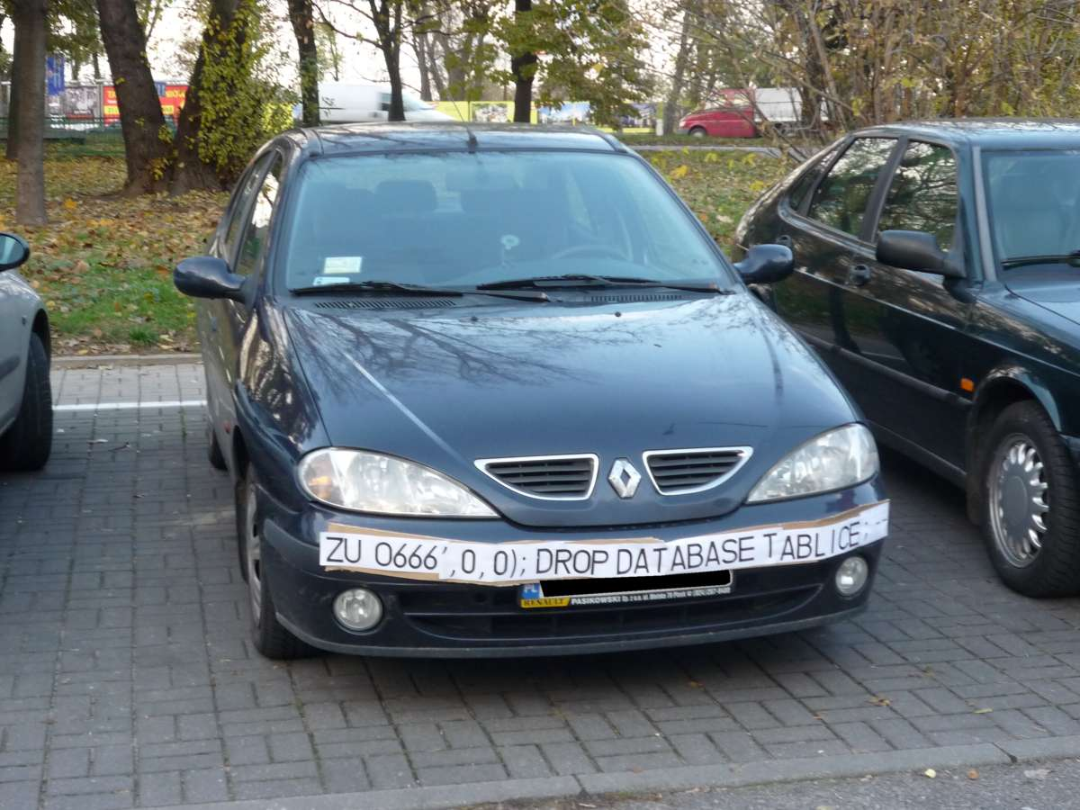
SQL INJECTION

Slide 48
SQL Injection
This is a much larger topic with lots of info out there.
SQL Server is better than some RDBMS platforms but is not immune to SQL Injection attacks made possible by security-ignorant development.
Developers must be aware of SQL Injection-blocking patterns on public websites:
Parameterize the input from the website (use sprocs!)
Sanitize inputs of special characters
Don’t run websites logins with more databases permission than needed (again, use sprocs!)

Slide 49
what can you do to prevent SQL Injection?
Design tables with appropriate data types and lengths.
Insist on stored procedures for public-facing operations like searches. Be aware of what db’s have public apps.
Insist on stored procedures for Entity Framework (or other ORMs) operations involving 2+ entities.

Slide 50
what can you do to prevent SQL Injection?
Avoid apps running with permissions like the db_datareader and db_datawriter roles, and certainly not db_owner.
Avoid the use of EXECUTE AS in code, which could allow injected code to execute with elevated security.
Train devs on patterns of stored procedure parameter sanitizing. Never use EXEC() or sp_executesql with user-enterable data.

Slide 51
what can you do to prevent SQL Injection?
Provide links, attention, and visibility to PM’s and Dev’s for SQL Injection awareness.
Lobby for penetration testing and SQL Injection detection tasks in sprints.
With Azure SQL DB, enable Azure Threat Detection!

Slide 52
AZURE threat detection
Azure SQL Database Threat Detection is a security intelligence feature built into the Azure SQL Database, activated with a button click.
Detects potential vulnerabilities such as Potential SQL Injection attacks, brute force attacks, anomalous login patterns, and more.

Slide 53
Feature Restrictions
Azure SQL Database and SQL Server 2019 have a pair of minor anti-injection feature to disable a pair of common probing attacks.
An injection attack will use delay or error messages to probe for vulnerabilities. An Error Message could contain object names.
You can disable WAITFOR and all error messages for a database user or role. For example:
EXEC sp_add_feature_restriction N'ErrorMessages', N'User', N’WebUser’
EXEC sp_add_feature_restriction N’WaitFor', N'User', N’WebUser’
Bypassed if running your website as a sysadmin or db_owner!
Learn more: https://docs.microsoft.com/en-us/azure/sql-database/sql-database-feature-restrictions

Slide 54
SSMS Vulnerability Assessment
Built into SSMS, there is a Vulnerability Assessment tool available via Object Explorer in each Database -> Tasks.
Introduced in SSMS 17.4 in SQL 2017.
Many findings have to do with database-level permissions that we’re discussing today: PUBLIC, GUEST, user-defined roles, low-impact roles, orphaned roles, least privilege, and more.

Slide 55
Stored procedures
Stored procedures require EXECUTE to run, and do not require all underlying object permissions (SELECT, INSERT, DELETE)…
…provided that the sproc doesn’t perform IDENTITY_INSERT on a table, which requires ALTER permissions not abstracted.
…provided that all the underlying objects have the same ownership chain.
…provided that the stored procedures do not use dynamic sql commands exec sp_executesql @SQL or EXEC(@SQL)

Slide 56
Stored procedures
Given those conditions, thanks to the database permission chain, you can:
GRANT EXEC rights to sprocs that INSERT UPDATE and SELECT from a table.
GRANT no other permissions to the table!
The user can read data in the table using the sproc ONLY.

Slide 57
Stored procedures
Consider DENYing SELECT rights to the public role, which is inherited by all user roles aside from db_owner and sysadmin.
Users prevented from accessing any tables or views directly from any application (SSMS, Access, Excel!).
User access to data is forced through sprocs. (Good!)

Slide 58
Views
Similar to stored procedures, a VIEW will allow a user to SELECT data from tables to which the user does not have access. (This is helpful!)

Slide 59
User-Defined Functions (UDF)
Similar to stored procedures, a UDF will allow a user to SELECT data from tables that the user does not have access to.
Keep in mind the performance impact of functions can be severe, especially in the SELECT portion of a query.
Overuse of UDF’s are common causes for performance issues. High potential for cursor-like effects.

Slide 60
laB
Demonstrate how Stored Procedures, Views, and Functions abstract the permissions necessary to view underlying table data.
Toolbox\Security p1.sql – logged in as sysadmin
Toolbox\Security p2.sql – logged in as testing user

Slide 61
Builtin\administratorS
Prior to SQL 2008, [BUILTIN\Administrators] was a member of the SQL sysadmin role.
This was a security hole – allowing anyone who gained admin access to a Windows Server to automatically and easily have sysadmin access.
SQL 2008 – BUILTIN\Administrators no longer have automatic rights to the SQL server and should NOT be granted access.

Slide 62
dbo
In SQL 2000, sales.dbo.customers meant:
databasename = sales
owner = dbo
tablename = customers
In 2005 and later, sales.dbo.customers meant:
databasename = sales
schema = dbo
tablename = customers

Slide 63
dbo
In SQL 2000, dbo was a special user inside each database with sysadmin permissions, which by default owned any object created by an admin.
In SQL 2005 and above, dbo is the default schema and no longer a security object. Saying a user has “dbo permissions” is incorrect.
[db_owner] is just a user role with no server-level permissions.

Slide 64
ownership
Microsoft has done away with the terminology of Users or Logins “owning” objects, such as databases and schemas.
Changing the AUTHORIZATION is now the more accurate term to describe “ownership” of an object.
For example, sp_changedbowner is deprecated, replaced by ALTER AUTHORIZATION

Slide 65
Schemas
A schema is a securable container
It contains database of objects, by default objects are inside the internal “dbo” schema.
Additional user schemas can be created. Permissions can be granted to schemas as a set.
Examples:
logical [Staging], [ODS], [Audit], [WH]
business [Sales], [HR], [Acct], [Inv]

Slide 66
Cross database ownership
A sproc/view can return data from a table in another database without permissions, if the two databases share the same owner login, by enabling Cross-Database Ownership Chaining on both databases.
This is not enabled by default on user databases. It has to be enabled at the server level then activated in each database…

Slide 67
Cross database ownership
Any login can take advantage of Cross-Database Ownership Chaining from another database.
Stored procedures and views – not queries - can then query other databases without any additional permissions.
Which could be very helpful, or a security risk…

Slide 68
Cross database ownership
It is possible that cross-database ownership can bypass your permissions by querying from the context of another database!
Enabling Cross-Database Ownership Chaining increases the necessary complexity of securing your data with minimum permissions.
You probably don’t need it, do it right.

Slide 69
Application roles
By executing sp_setapprole, a user connection inherits the permissions of an app role.
The application role has no permanent members, but is assigned permissions and given an app-only password.
The user connection assumes only the permissions of the application role.
You can utilize Active Directory-based Windows authentication without giving direct permissions.
Can be part of a strategy to force use of database to occur only via the application.

Slide 70
Application roles
Cons:
Accessing other databases requires the use of the guest role.
Connection pooling can be problematic (cookies)

Slide 71
Continued reading
http://msdn.microsoft.com/en-us/library/ms191291.aspx
https://docs.microsoft.com/en-us/sql/connect/oledb/oledb-driver-for-sql-server?view=sql-server-2017
https://blogs.msdn.microsoft.com/sqlnativeclient/2017/10/06/announcing-the-new-release-of-ole-db-driver-for-sql-server/
https://techcommunity.microsoft.com/t5/SQL-Server/ODBC-Driver-17-for-SQL-Server-Released/ba-p/385825
http://social.technet.microsoft.com/wiki/cfs-file.ashx/__key/communityserver-wikis-components-files/00-00-00-00-05/5710.Permissions_5F00_Poster_5F00_2008_5F00_R2_5F00_Wiki.pdf
http://msdn.microsoft.com/en-us/library/bb669058(v=VS.110).aspx
http://blogs.msdn.com/b/sqlsecurity/archive/2011/08/25/database-engine-permission-basics.aspx
http://msdn.microsoft.com/en-us/library/ms191465.aspx
https://docs.microsoft.com/en-us/sql/relational-databases/databases/security-best-practices-with-contained-databases?view=sql-server-2017
https://azure.microsoft.com/en-us/blog/azure-sql-database-threat-detection-your-built-in-security-expert/
https://www.slideshare.net/GrantFritchey/sql-injection-what-it-is-how-to-stop-it
http://technet.microsoft.com/en-us/library/ms187359.aspx
http://support.microsoft.com/kb/918992
https://azure.microsoft.com/en-us/documentation/articles/sql-database-aad-authentication/
https://azure.microsoft.com/en-us/documentation/articles/sql-database-manage-logins/

Slide 72

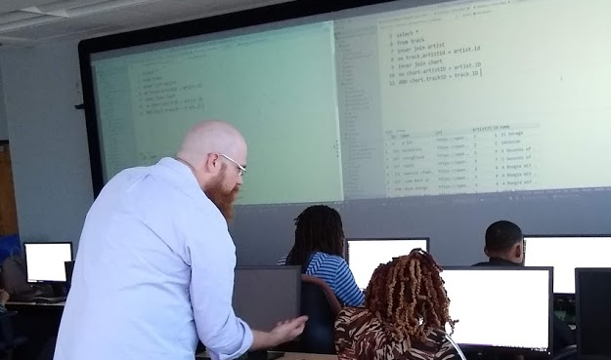
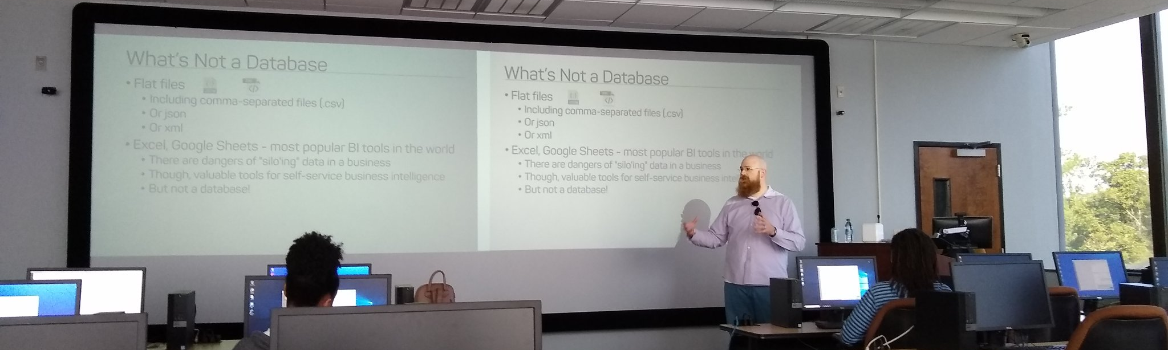
Support your Local STEM Initiatives
I encourage you to find, then donate time and money to local STEM education initiatives where you live. Get involved!
There is almost certainly some nonprofit where you live that needs your enthusiasm and skills to close the achievement gap.
https://www.thewallsproject.org/programs/futures_fund/

Slide 73
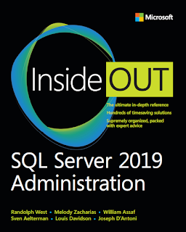
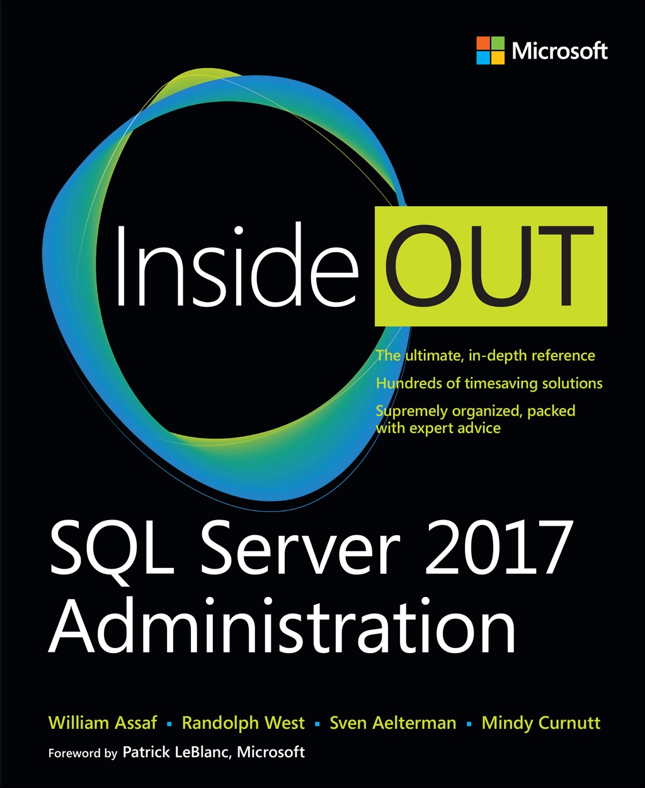
SQL Server 2017 Inside Out
SQL Server 2019 Administration Inside Out
by Microsoft Press
2017 published Feb 2018
2019 coming March 2020

Slide 74

Bio and contact
William D Assaf, MCSE
Baton Rouge SQL Server UG board
Principal Consultant, SQL Manager at Sparkhound
William.Assaf@sparkhound.com
Twitter: @william_a_dba
This presentation, including all source code, available at my blog:
SQLTact.com

Slide 75
UpCOMING EVENTS
Baton Rouge .NET UG
brdnug.org
Every 2nd Wednesday
Baton Rouge SQL Server UG
brssug.org
Baton Rouge Analytics and Intelligence Network
gobrain.org
Baton Rouge SQLSaturday
At LSU
March 7 – BI
August 1 – Everything
SQLSaturday.com
Activate Conference
At LSU
September 19 2020
ActivateConf.com

